Slide 1


Machine Learning
Project
Hanxiao SUN

Slide 2

Background
Criteo — Company Background
Founded in 2005 in France, a global Commerce Media company.
Core purpose
Provides a Commerce Media platform that connects advertising directly to the shopping journey
Helps brands reach consumers at the moment of purchase decision, not just during awareness
Who it serves
Brands / Retailers / Media owners & publishers / Agencies

Slide 3
Main objectives
Split the dataset into two groups based on the treatment variable:
treatment = 0 as the control group and treatment = 1 as the treatment (experimental) group.
Train separate logistic regression models for the control group and the treatment group to predict whether a user will convert, and evaluate their performance on the test set.
Use the two trained models to estimate uplift values and analyze the impact of advertising on user conversion behavior.
A set of features
The conversion probability calculated by the experimental group
The conversion probability calculated by the control group

Slide 4
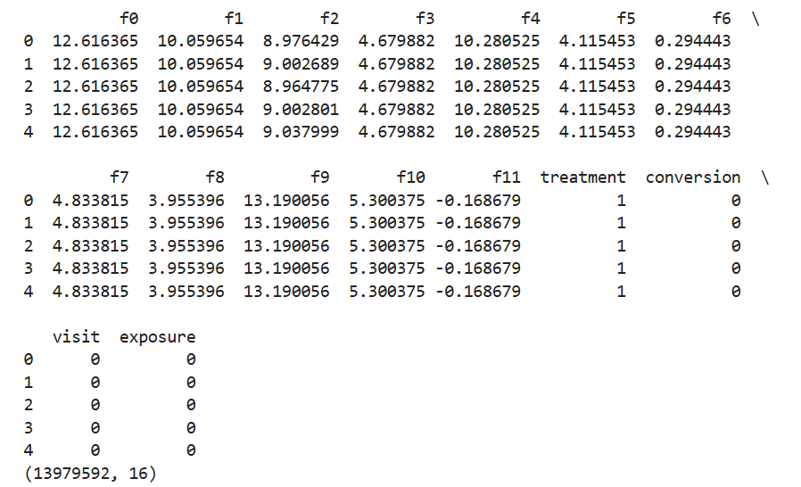
Data Structures
treatment
Whether the user is assigned to the treatment group
conversion
Whether the user converted, e.g. purchase
visit
Whether the user visited the website
exposure
Whether the user was exposed to the advertisement

Slide 5
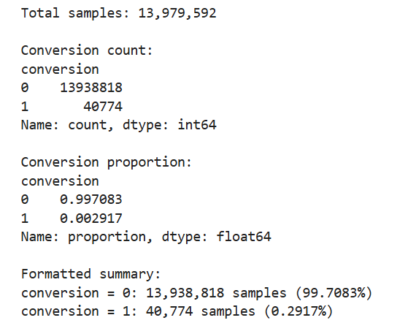
Original data distribution
Too few positive samples

Slide 6
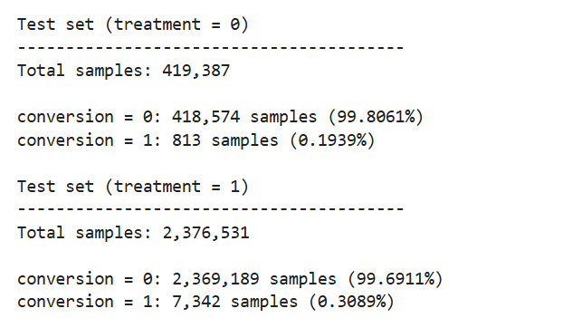
Split test set
Keep the ratio(conversion=0/1) as the original dataset

Slide 7
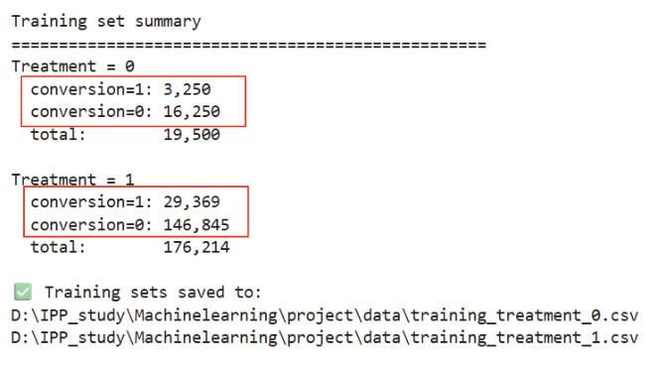
Downsampling the training set
Problem: Class imbalance
Method: Downsampling the training set
Resulting class distribution: conversion = 0 : conversion = 1 = 5 : 1

Slide 8
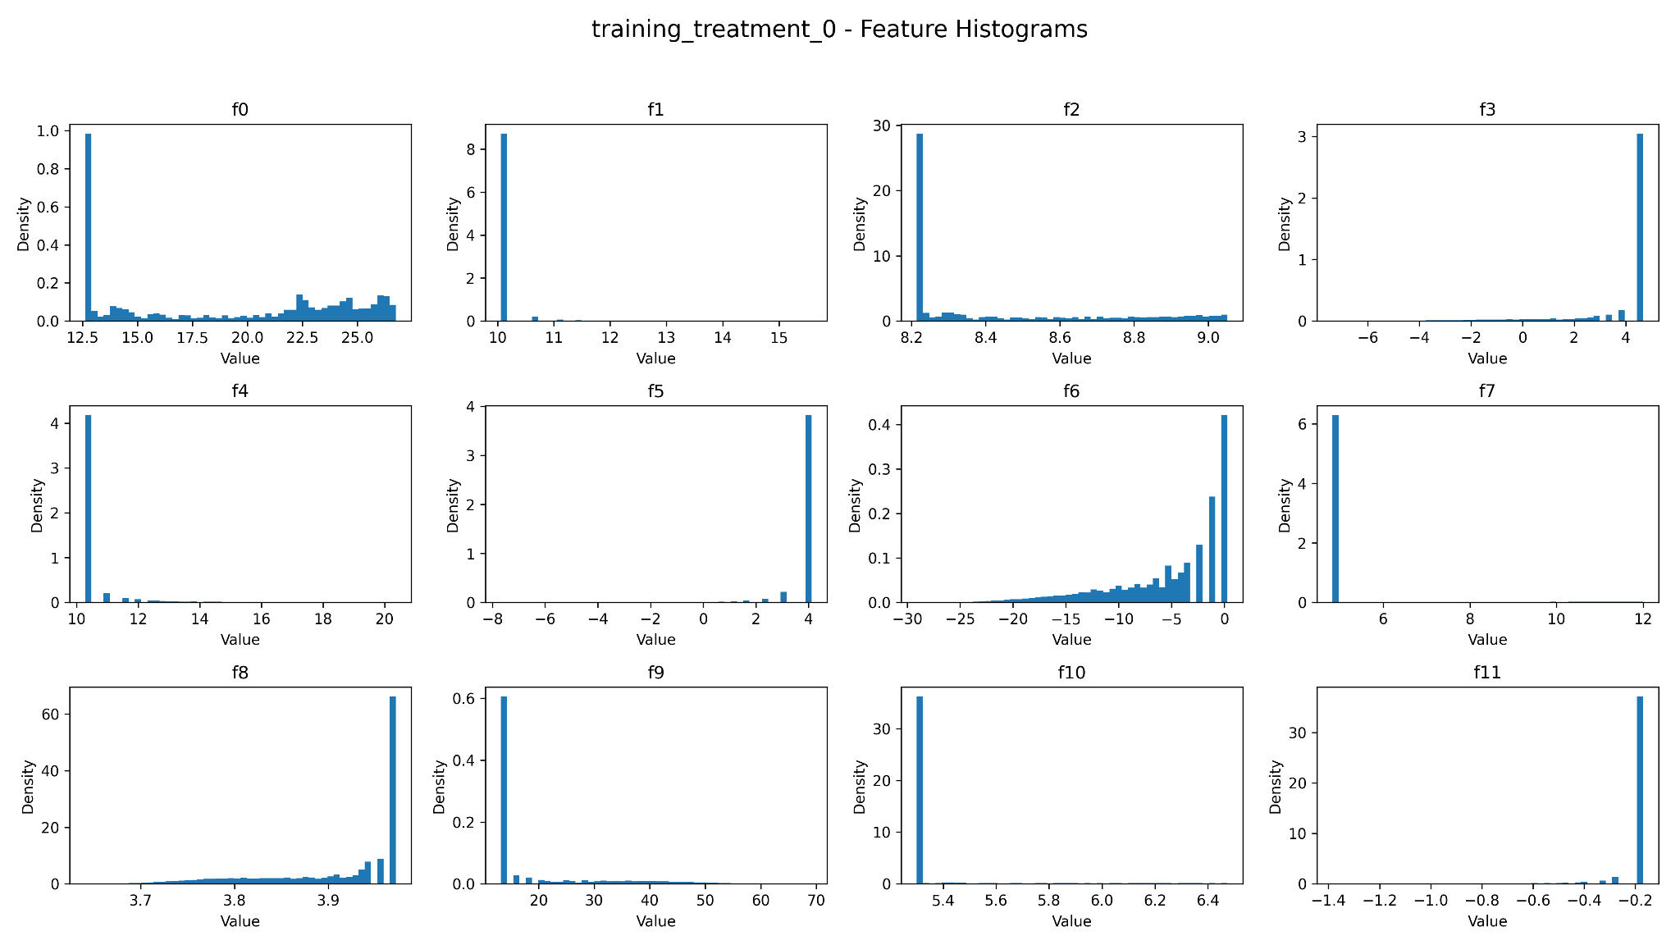
Data characteristics

Slide 9
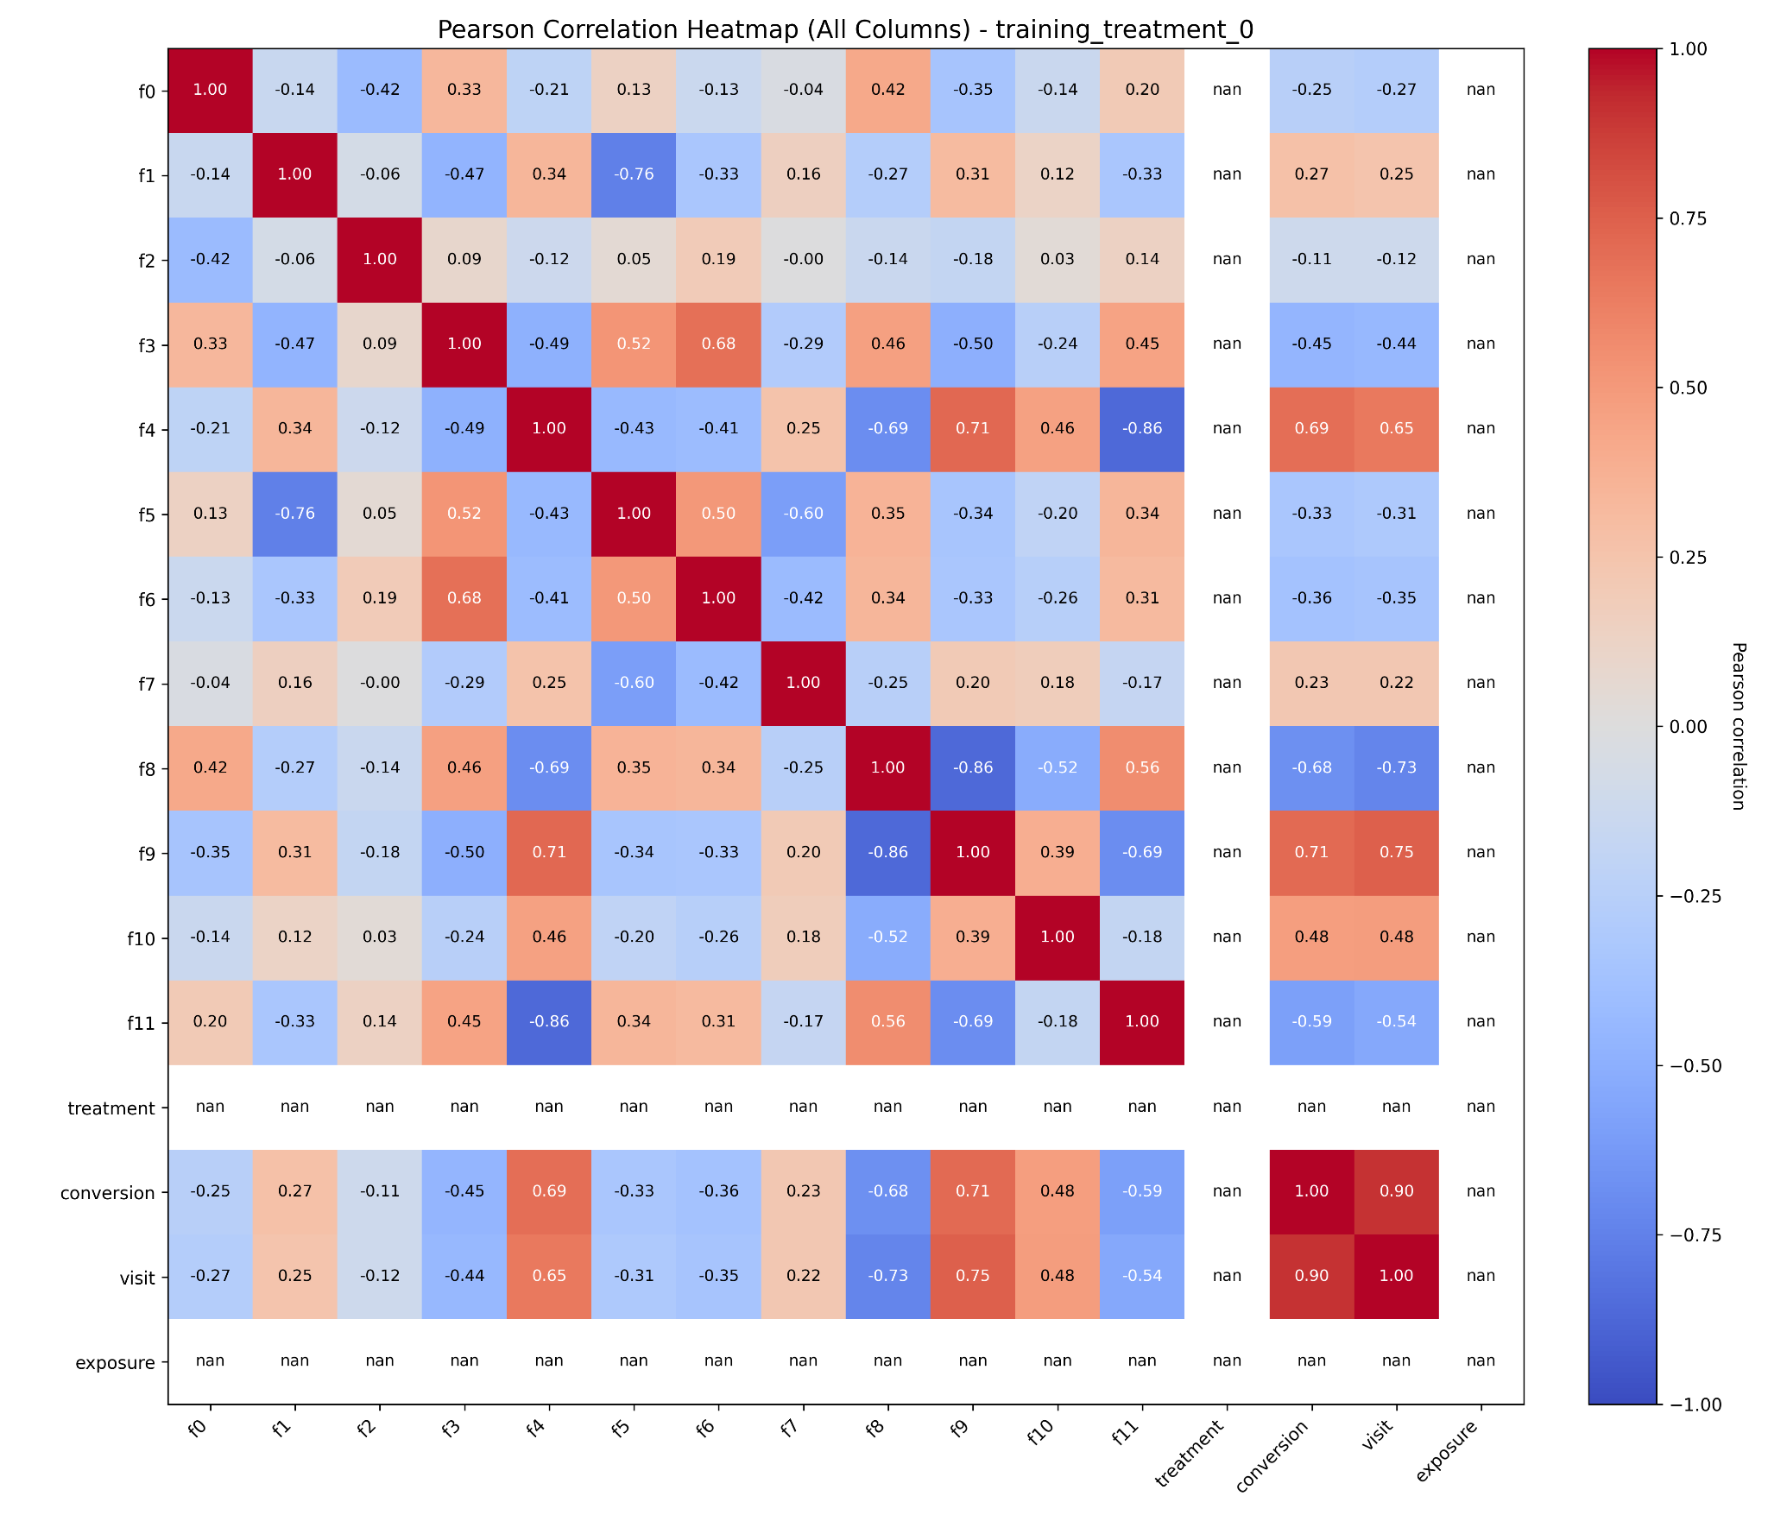
Heatmap treatement = 0

Slide 10
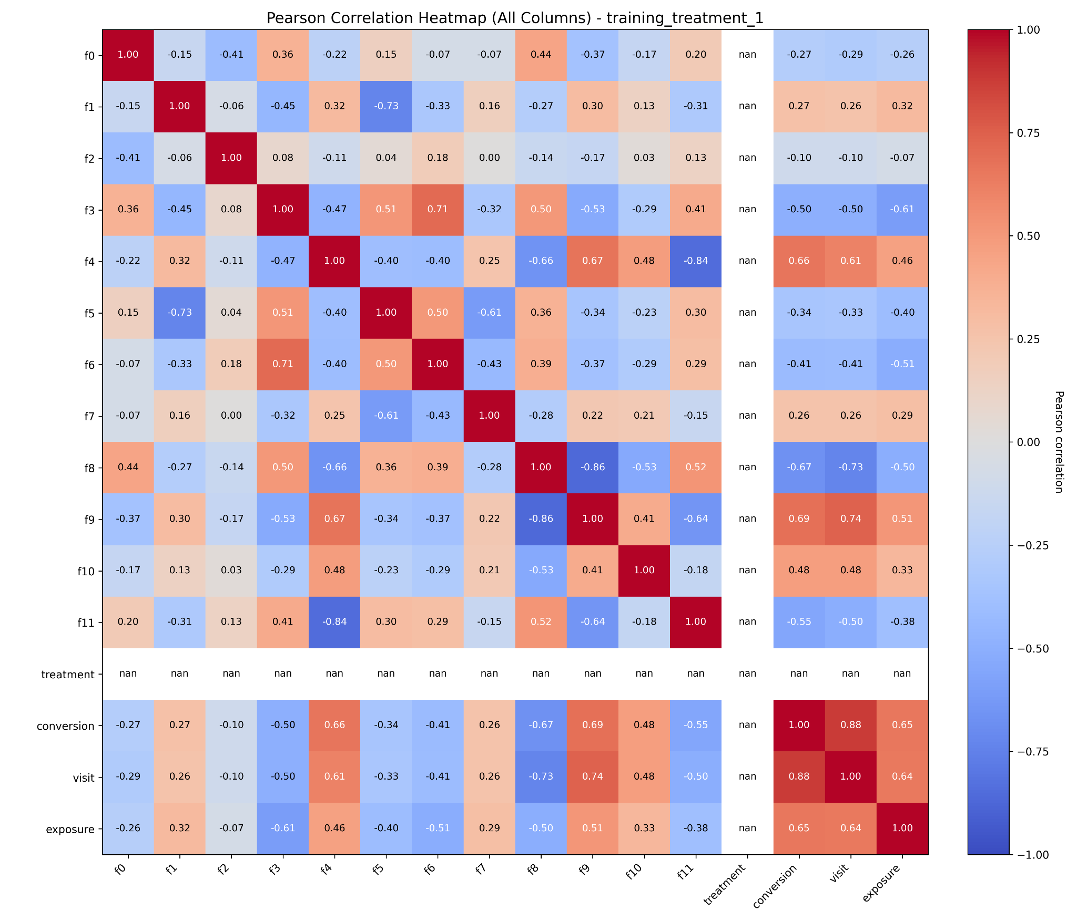
Heatmap treatment = 1

Slide 11
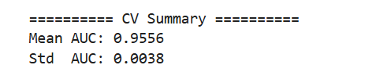

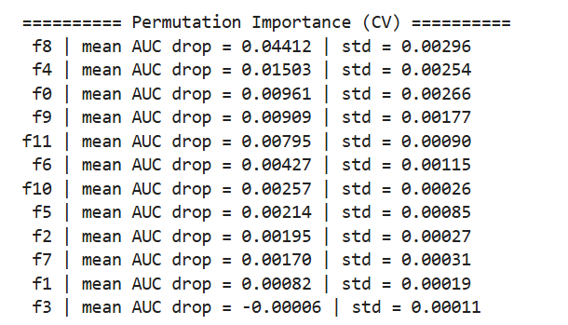
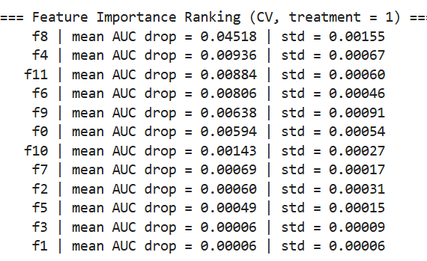
5-folds training
Treatment=0
Treatment=1

Slide 12
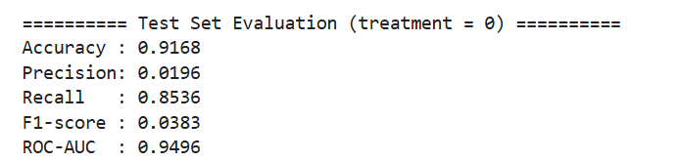
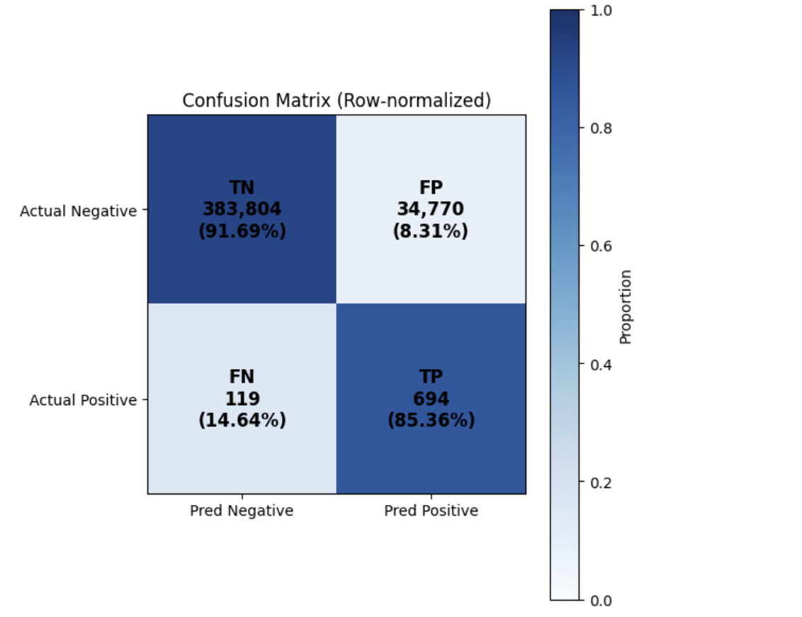
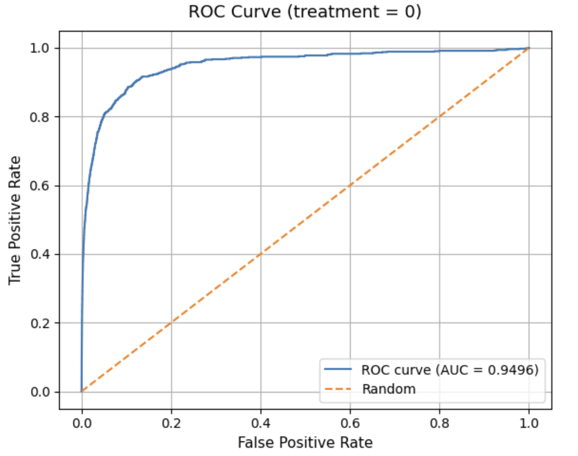
Evaluation treatment = 0
training

Slide 13
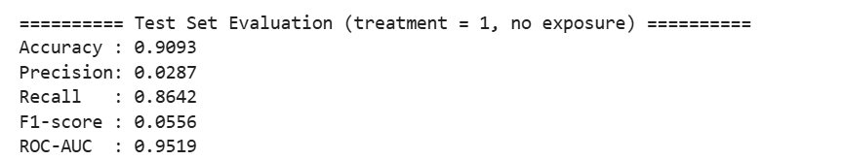
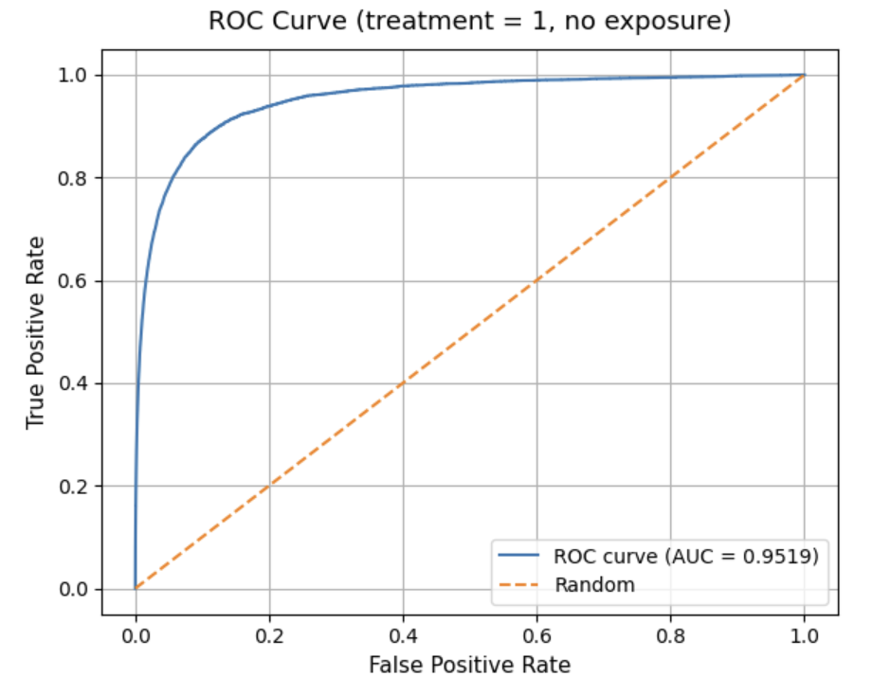
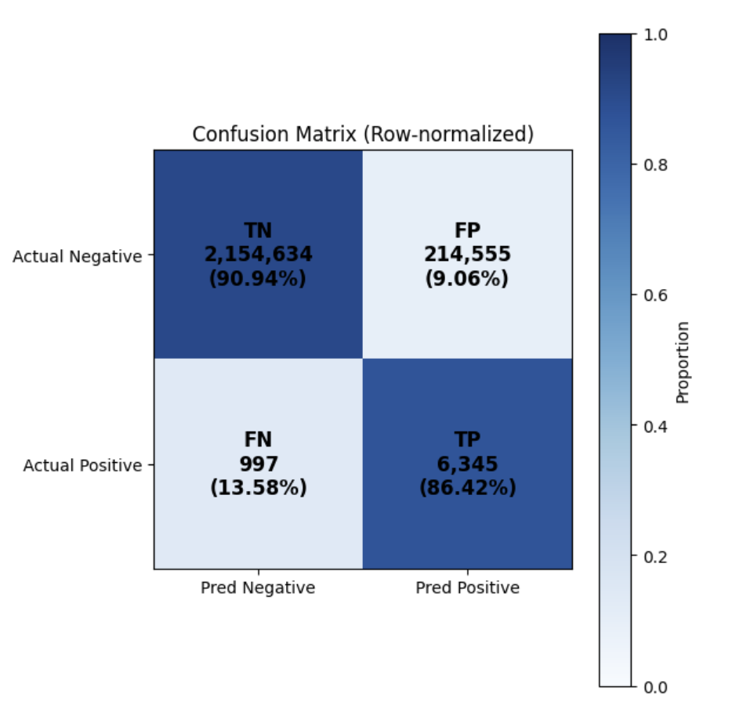
Evaluation treatment = 1
training

Slide 14
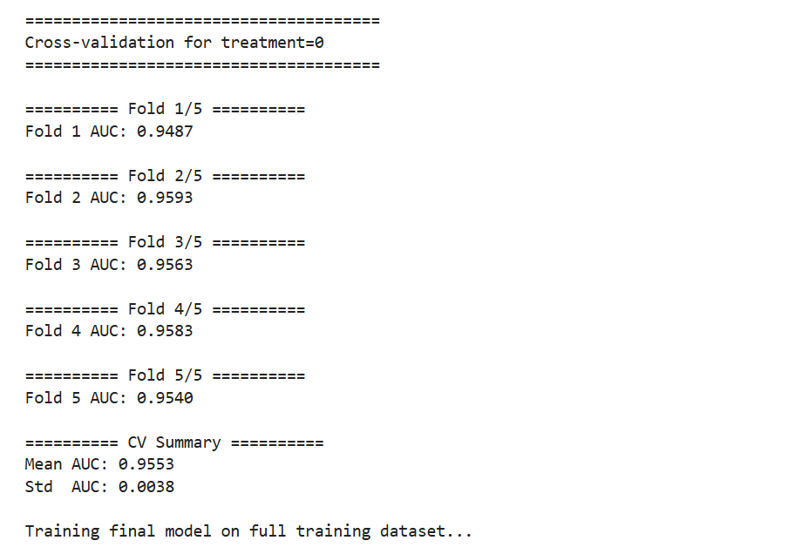
Training with full data t0
train with downsampling set

Slide 15
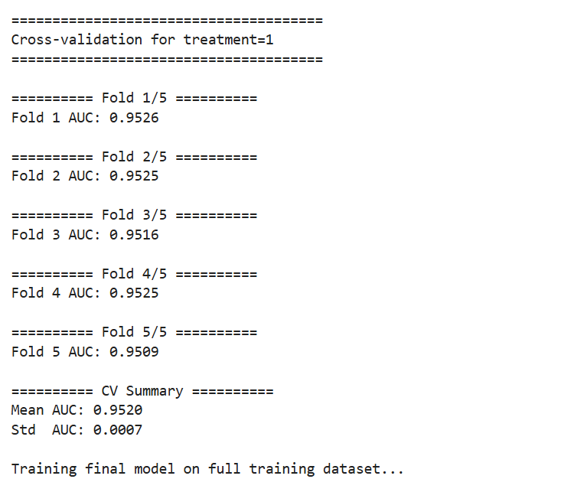
Training with full data t1
train with downsampling set

Slide 16
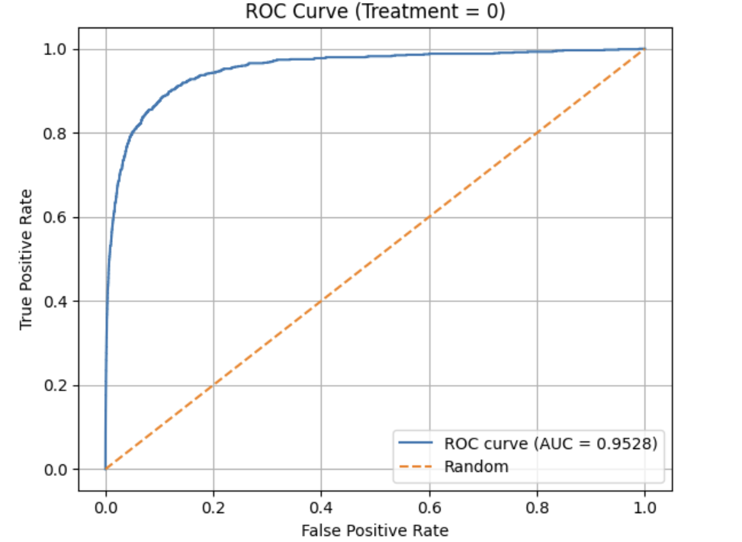
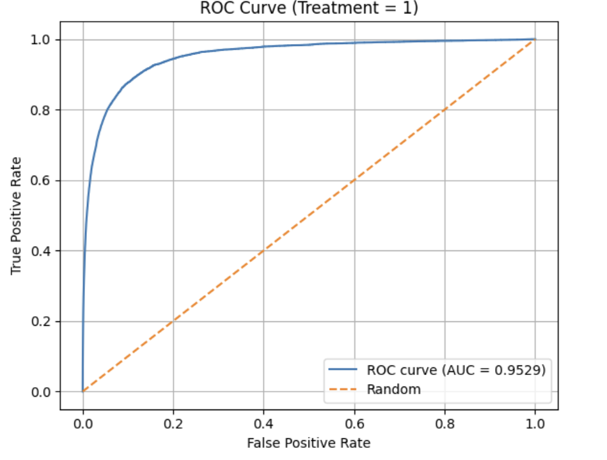

Evaluation for full data
Find best threshold:
maximizing the true positive rate & minimizing the false positive rate

Slide 17
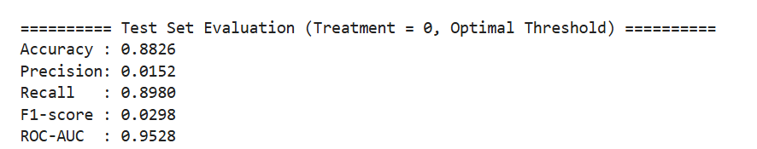
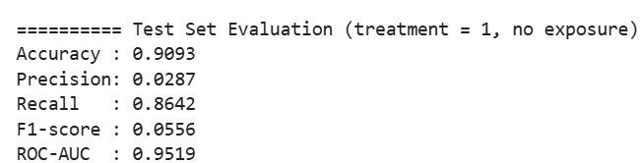
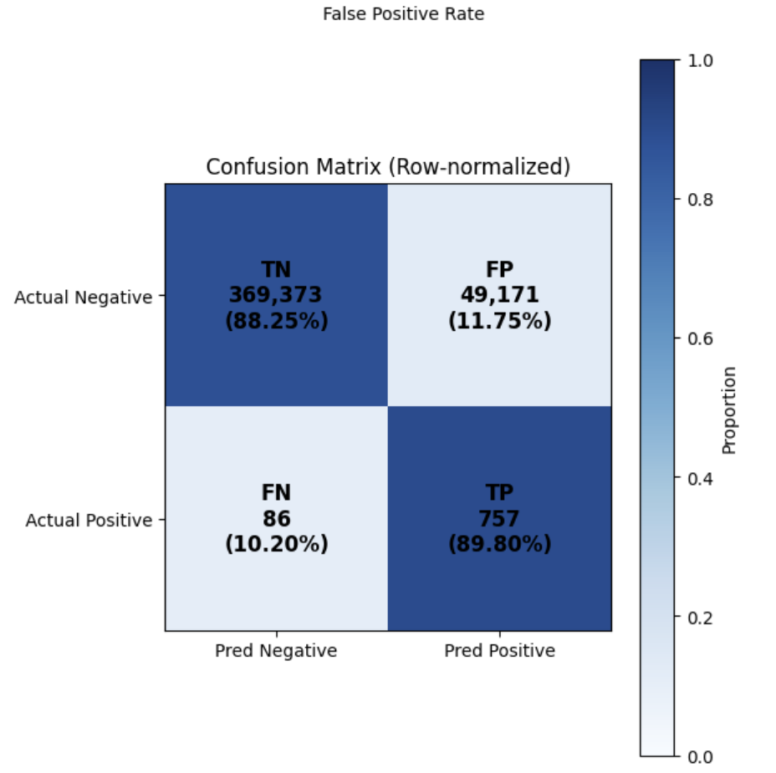
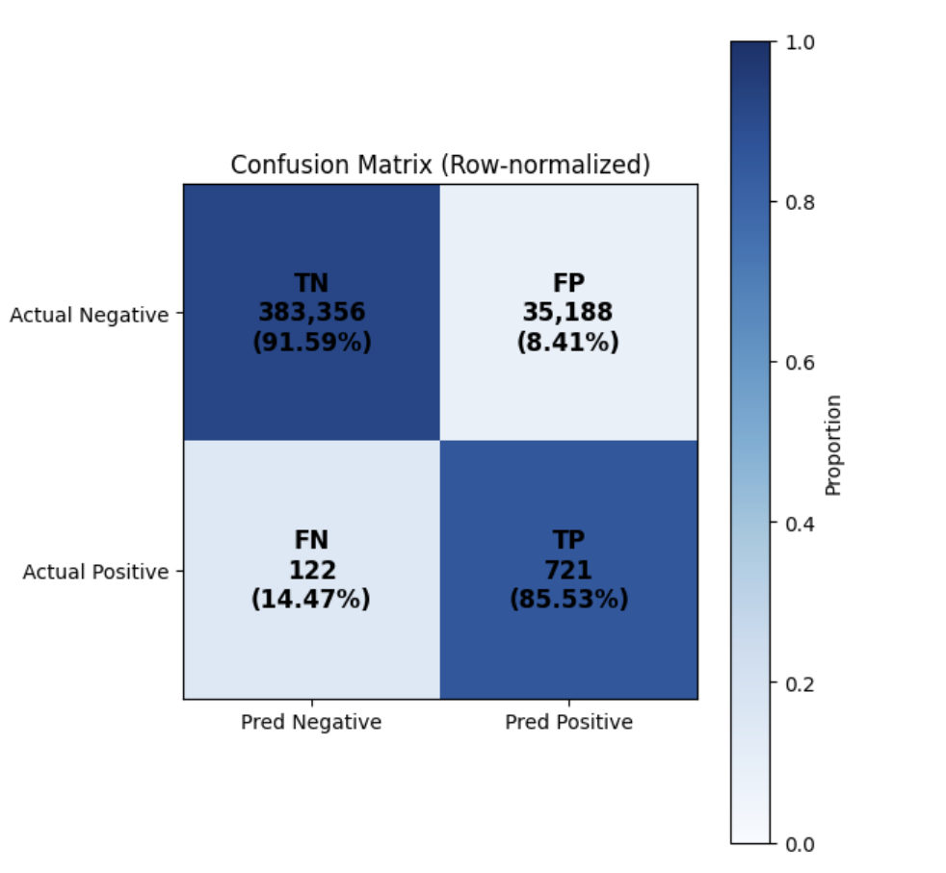
Evaluation for full data t0
0.3608
0.5

Slide 18
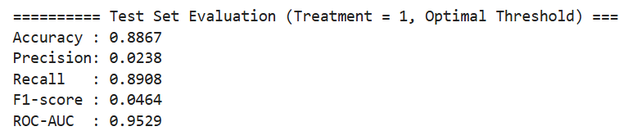
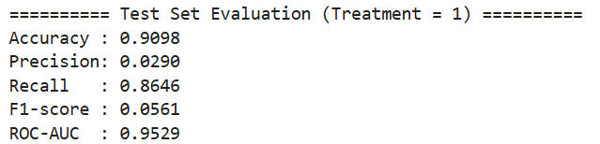
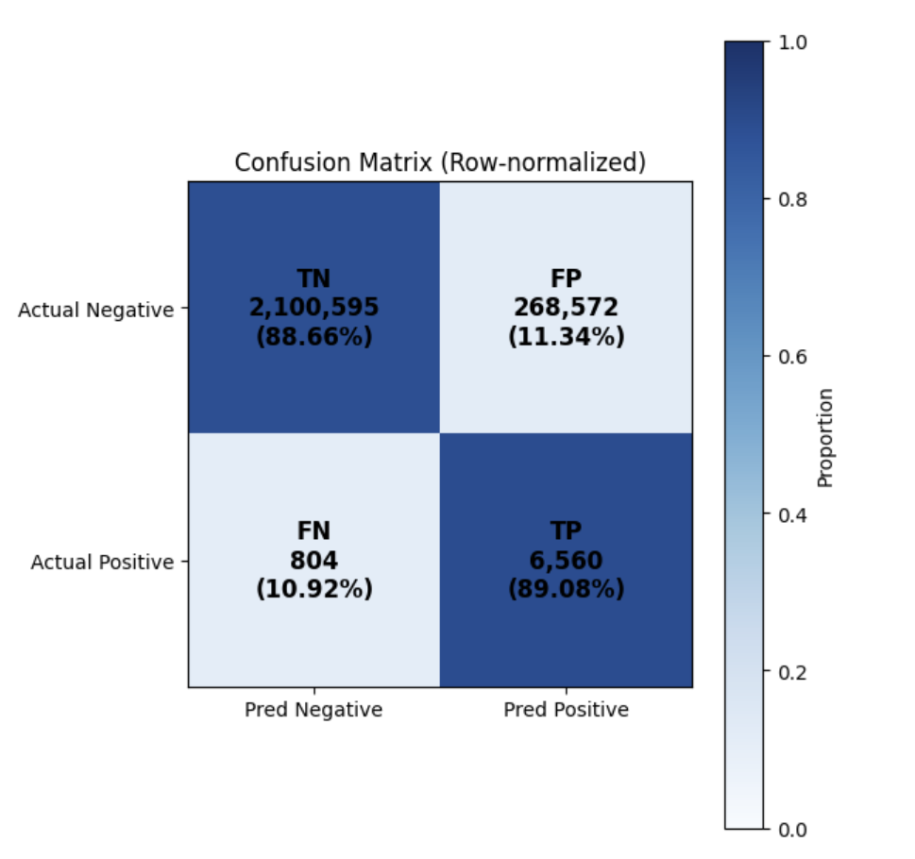

Evaluation for full data t1
0.4013
0.5

Slide 19
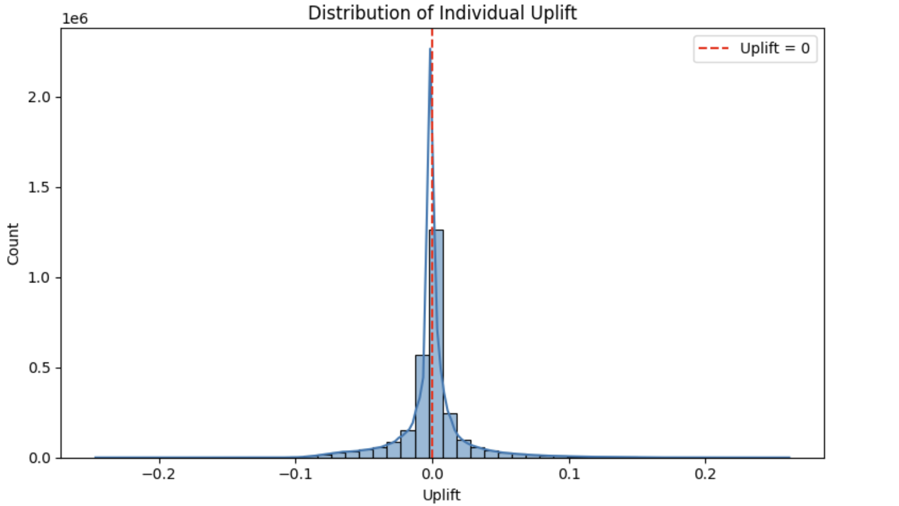
Uplift Result with full data

Slide 20
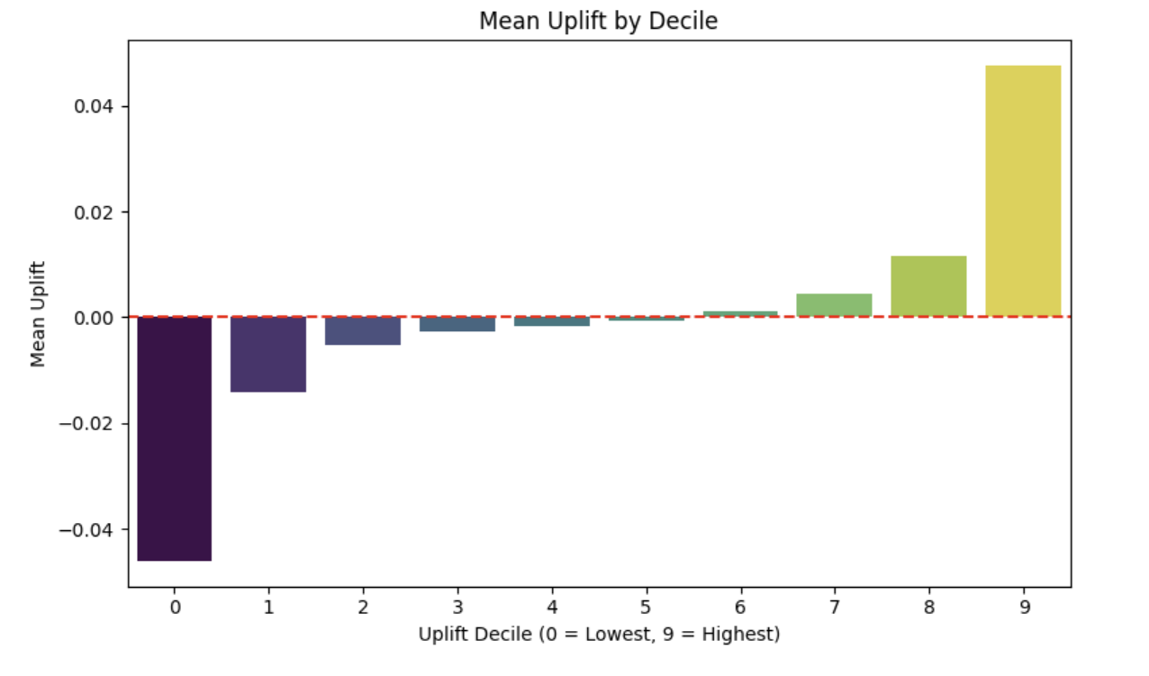
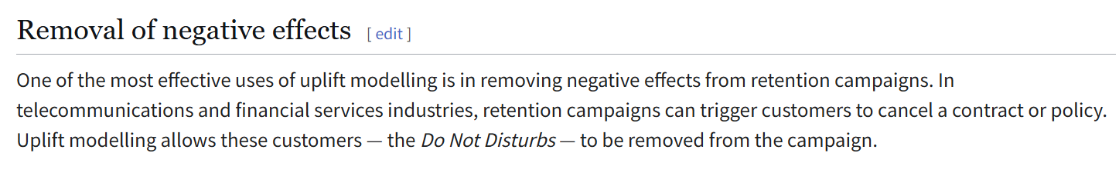
Uplift result with full data
The Persuadables: customers who only respond to the marketing action because they were targeted
The Lost Causes: customers who will not respond irrespective of whether or not they are targeted
The Do Not Disturbs or Sleeping Dogs: customers who are less likely to respond because they were targeted

Slide 21
Thank you !

